Slide 2
Objectives Overview
Describe the types of output
Explain the characteristics of various display devices
Describe the factors that affect the quality of an LCD monitor or LCD screen
Describe various ways to print
Differentiate between a nonimpact printer and an impact printer
See Page 303
for Detailed Objectives

Slide 3
Objectives Overview
Summarize the characteristics of ink-jet printers, photo printers, laser printers, multifunction peripherals, thermal printers, mobile printers, label and postage printers, and plotters and large-format printers
Describe the uses and characteristics of speakers, headphones, and earbuds
Identify the purpose and features of data projectors, interactive whiteboards, and force-feedback game controllers and tactile output
Identify output options for physically challenged users
See Page 303
for Detailed Objectives

Slide 4
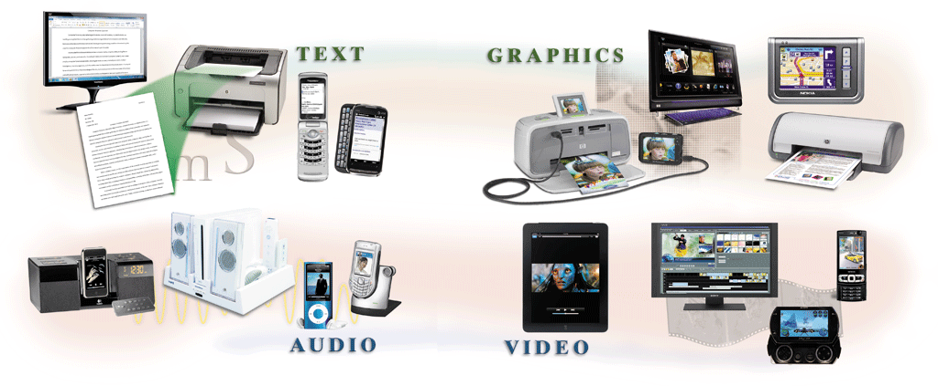
What Is Output?
Output is data that has been processed into a useful form
Pages 304 – 305
Figure 6-1

Slide 5
What Is Output?
An output device is any type of hardware component that conveys information to one or more people
Display devices
Printers
Speakers, headphones, and earbuds
Data projectors
Interactive whiteboards
Force-feedback game controllers
Tactile output
Page 305

Slide 6
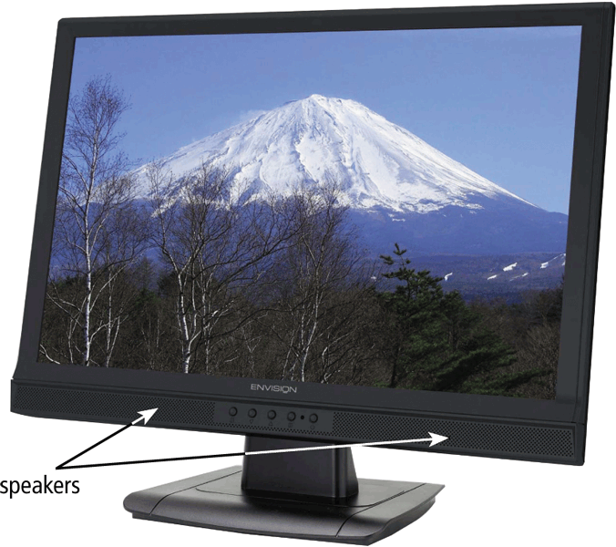
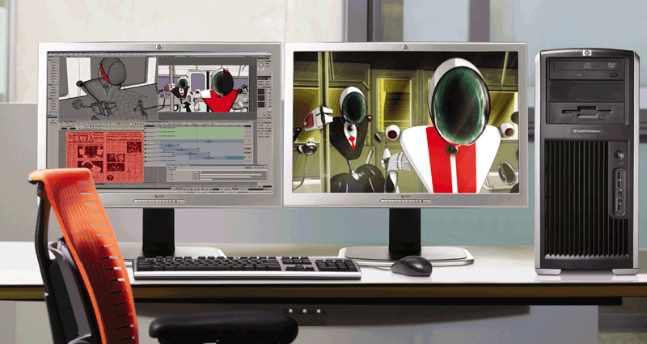
Display Devices
A display device visually conveys text, graphics, and video information
A monitor is packaged as a separate peripheral
LCD monitor
Widescreen
Pages 306 – 207
Figures 6-2 – 6-3

Slide 7
Display Devices
Liquid crystal display (LCD) uses a liquid compound to present information on a display device
Active-matrix display
Passive-matrix display
Page 308

Slide 8
Display Devices
The quality of an LCD monitor or LCD screen depends primarily on:
Resolution
Response time
Brightness
Dot pitch
Contrast ratio
Pages 308 - 310

Slide 9
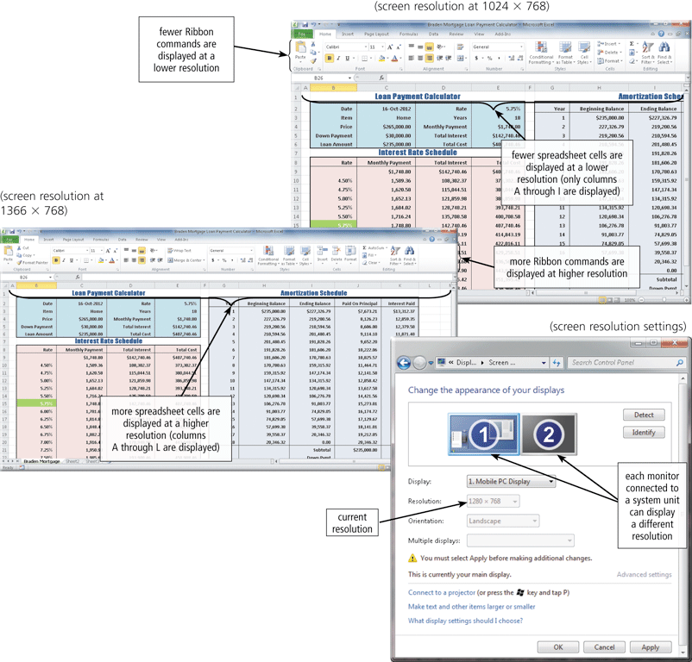
Display Devices
Resolution is the number of horizontal and vertical pixels in a display device
A higher resolution uses a greater number of pixels
Pages 308 – 309
Figure 6-5

Slide 10
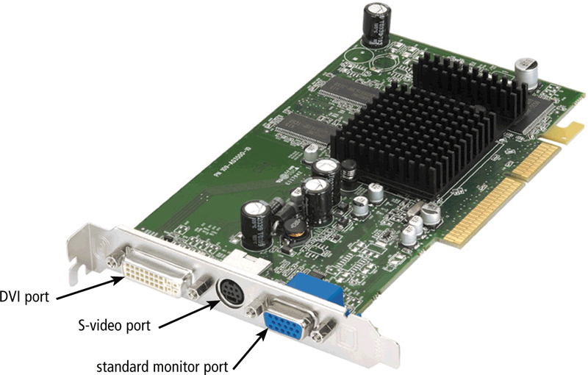
Display Devices
The graphics processing unit (GPU) controls the manipulation and display of graphics on a display device
LCD monitors use a digital signal and should plug into a DVI port, an HDMI port, or a DisplayPort
Page 310
Figure 6-6

Slide 11
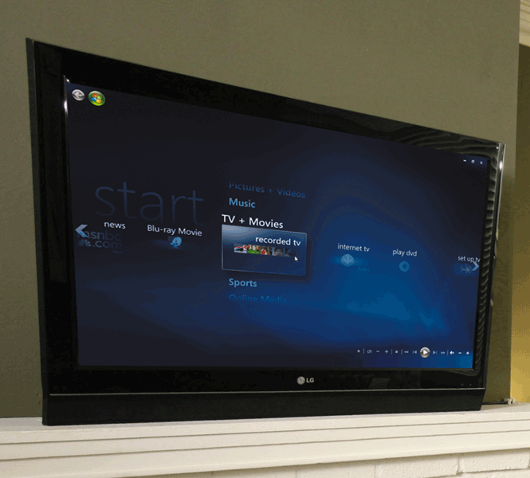
Display Devices
Plasma monitors are display devices that use gas plasma technology and offer screen sizes up to 150 inches
Page 311
Figure 6-8

Slide 12
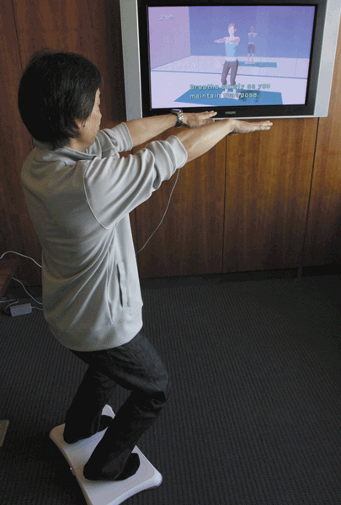
Display Devices
Televisions also are a good output device
Require a converter if you are connecting your computer to an analog television
Digital television (DTV) offers a crisper, higher-quality output
HDTV is the most advanced form of digital television
Page 312
Figure 6-9

Slide 13
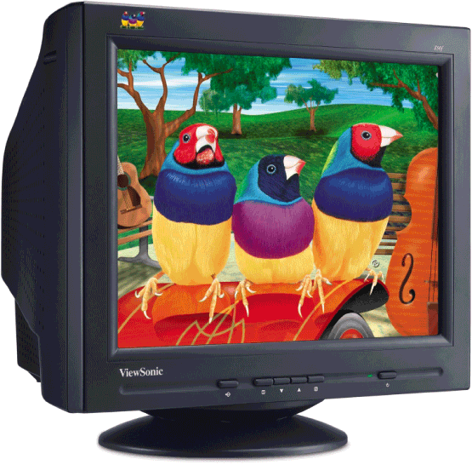
Display Devices
A CRT monitor is a desktop monitor that contains a cathode-ray tube
Have a much larger footprint than do LCD monitors
Page 313
Figure 6-10

Slide 14


Printers
A printer produces text and graphics on a physical medium
Printed information is called a hard copy, or printout
Landscape or portrait orientation
Page 313
Figure 6-11

Slide 15
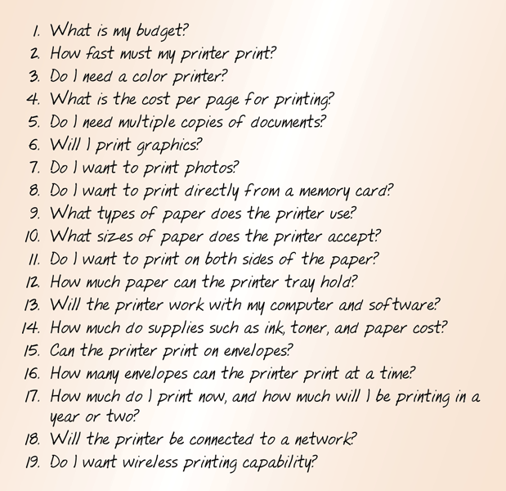
Printers
Before purchasing a printer, ask yourself a series of questions:
Page 314
Figure 6-12

Slide 16
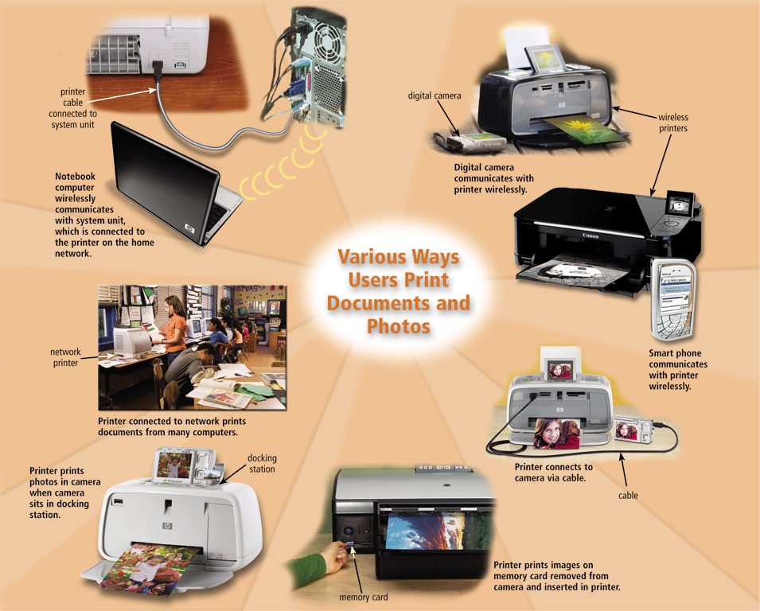
Printers
Page 315
Figure 6-13

Slide 17
Printers
A nonimpact printer forms characters and graphics on a piece of paper without actually striking the paper
Ink-jet printers
Photo printers
Laser printers
Thermal printers
Mobile printers
Label and postage printers
Plotters
Large-format printers
Page 315

Slide 18
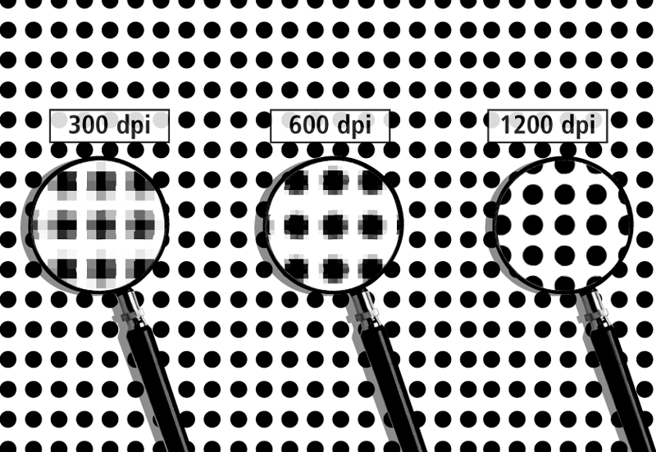
Printers
An ink-jet printer forms characters and graphics by spraying tiny drops of liquid ink onto a piece of paper
Color or black-and-white
Printers with a higher dpi (dots per inch) produce a higher quality output
Pages 316 – 317
Figure 6-15

Slide 19
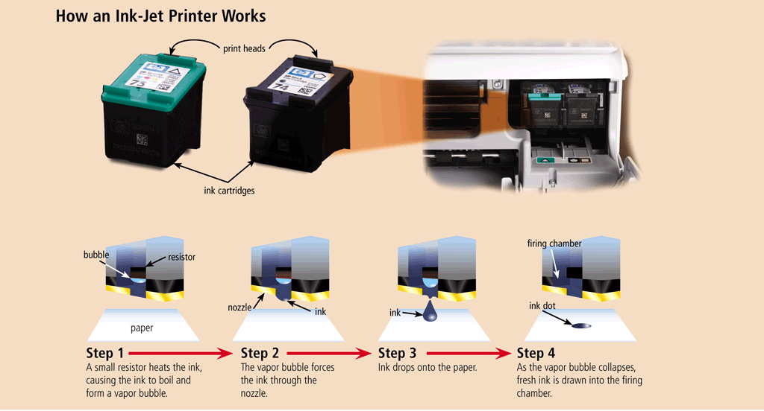
Printers
Page 317
Figure 6-16

Slide 20
Printers
A photo printer produces color photo-lab-quality pictures
Most use ink-jet technology
PictBridge allows you to print photos directly from a digital camera
Print from a memory card and preview photos on a built-in LCD screen
Page 318

Slide 21
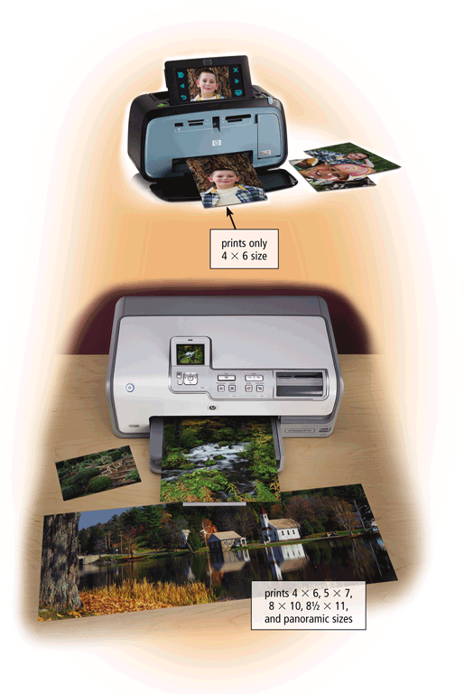
Printers
Page 318
Figure 6-17

Slide 22
Printers
Laser printer
High-speed
High-quality
Color
Black-and-white
Pages 319 - 320

Slide 23
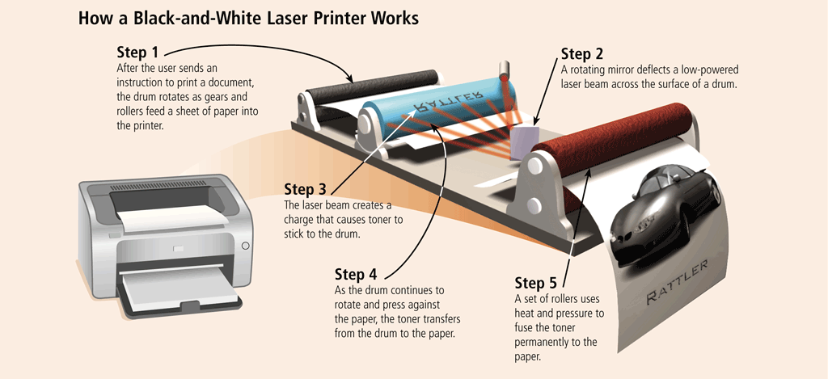
Printers
Page 320
Figure 6-19

Slide 24
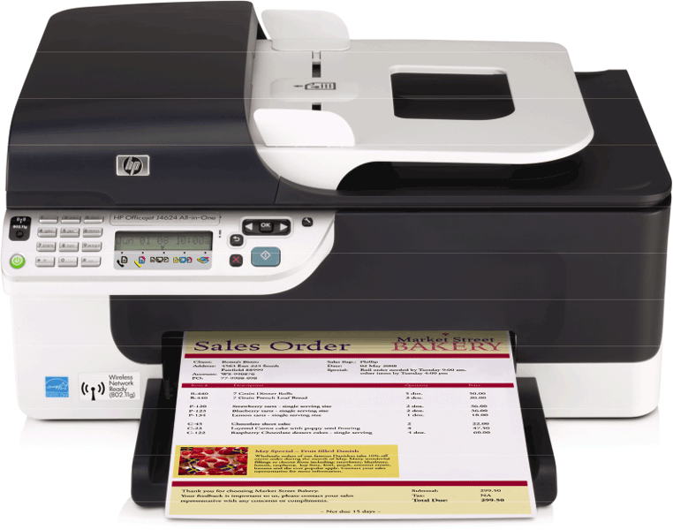
Printers
A multifunction peripheral (MFP) is a single device that prints, scans, copies, and in some cases, faxes
Sometimes called an all-in-one device
Pages 320 – 321
Figure 6-20

Slide 25
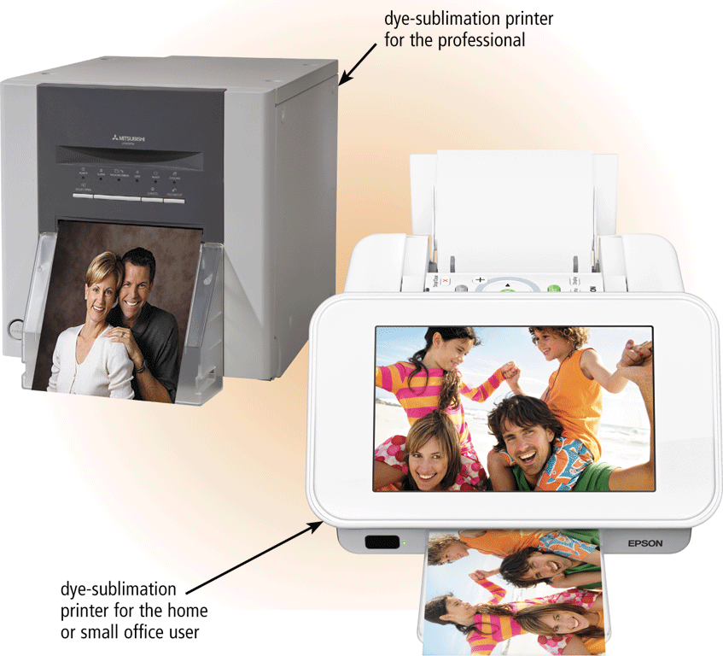
Printers
A thermal printer generates images by pushing electrically heated pins against the heat-sensitive paper
Thermal wax-transfer printer
Dye-sublimation printer
Page 321
Figure 6-21

Slide 26
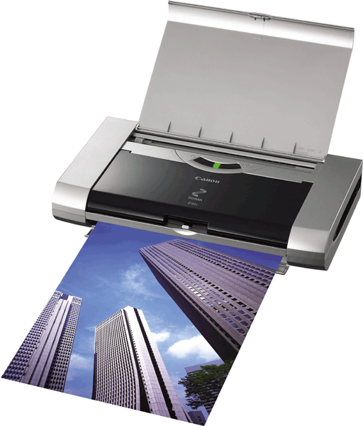
Printers
A mobile printer is a small, lightweight, battery-powered printer that allows a mobile user to print from a notebook computer, smart phone, or other mobile device
Page 321
Figure 6-22

Slide 27
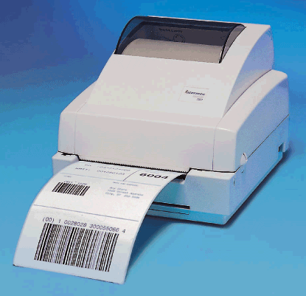
Printers
A label printer is a small printer that prints on adhesive-type material
A postage printer prints postage stamps
Postage also can be printed on other types of printers
Page 322
Figure 6-23

Slide 28
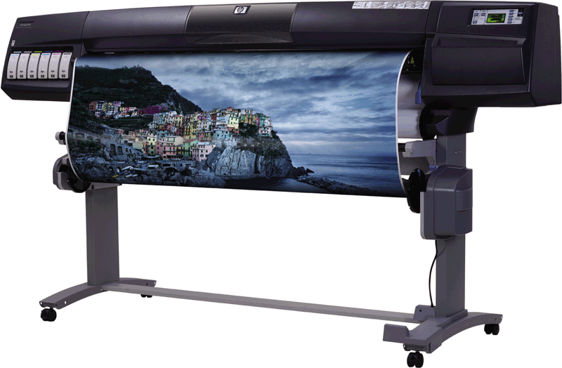
Printers
Plotters are used to produce high-quality drawings
Large-format printers create photo-realistic quality color prints on a larger scale
Page 322
Figure 6-24

Slide 29
Printers
Impact printers form characters and graphics on a piece of paper by striking a mechanism against an inked ribbon that physically contacts the paper
Dot-matrix printer
Line printer
Pages 322 - 323

Slide 30
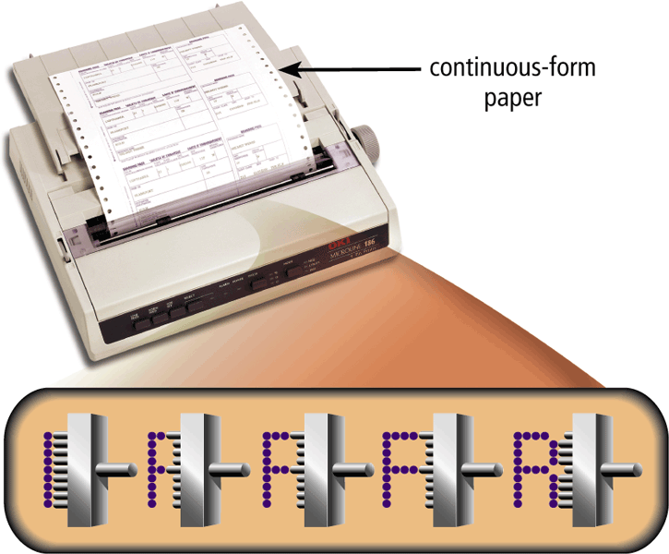
Printers
A dot-matrix printer produces printed images when tiny wire pins on a print head mechanism strike an inked ribbon
A line printer prints an entire line at a time
Page 323
Figure 6-25

Slide 31
Speakers, Headphones, and Earbuds
An audio output device produces music, speech, or other sounds
Most computer users attach speakers to their computers to:
Generate higher-quality sounds for playing games
Interact with multimedia presentations
Listen to music
View movies
Page 323
Figure 6-26

Slide 32

Speakers, Headphones, and Earbuds
Headphones are speakers that cover or are placed outside of the ear
Earbuds (also called earphones) rest inside the ear canal
Page 324
Figure 6-27

Slide 33
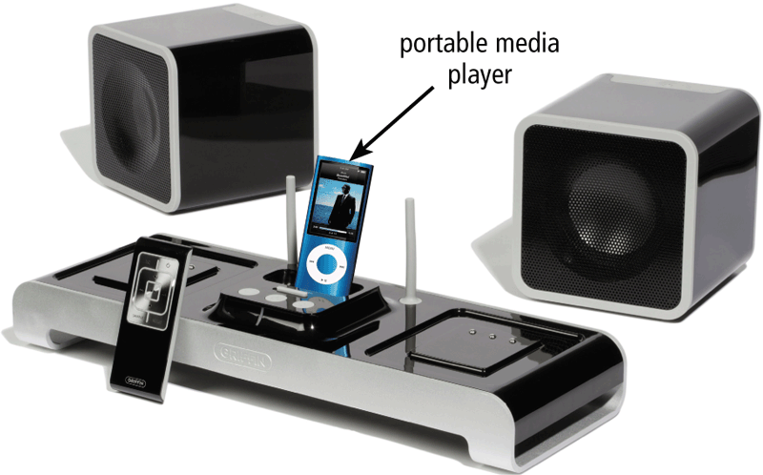
Speakers, Headphones, and Earbuds
Some speakers are specifically designed to play audio from a portable media player
Wireless speakers
Page 324
Figure 6-28

Slide 34
Speakers, Headphones, and Earbuds
Voice output occurs when you hear a person’s voice or when the computer talks to you through the speakers
Some Web sites dedicate themselves to providing voice output
Often works with voice input
VoIP uses voice output and voice input
Page 325

Slide 35
Other Output Devices
Other output devices are available for specific uses and applications
Data projectors
Interactive whiteboards
Force-feedback game controllers
Tactile output
Page 325

Slide 36
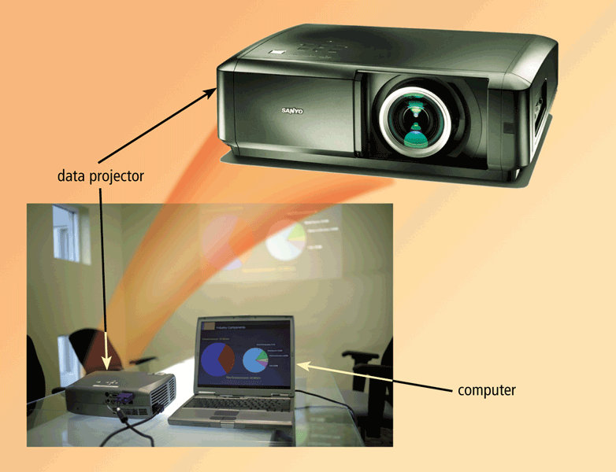
Other Output Devices
A data projector is a device that takes the text and images displaying on a computer screen and projects them on a larger screen
LCD projector
Digital light processing (DLP) projector
Pages 325 - 326
Figure 6-29

Slide 37

Other Output Devices
An interactive whiteboard is a touch-sensitive device, resembling a dry-erase board, that displays the image on a connected computer screen
Page 326
Figure 6-30

Slide 38
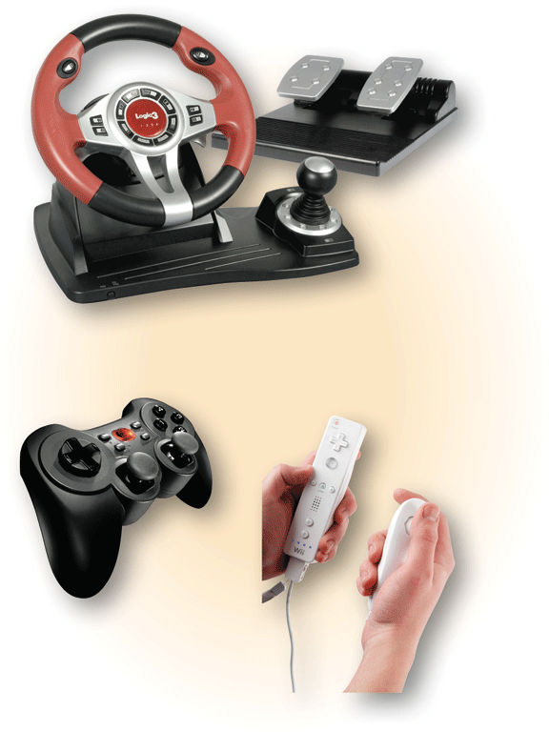
Other Output Devices
Force-feedback sends resistance to the device in response to actions of the user
Tactile output provides the user with a physical response from the device
Pages 326 – 327
Figure 6-31

Slide 39
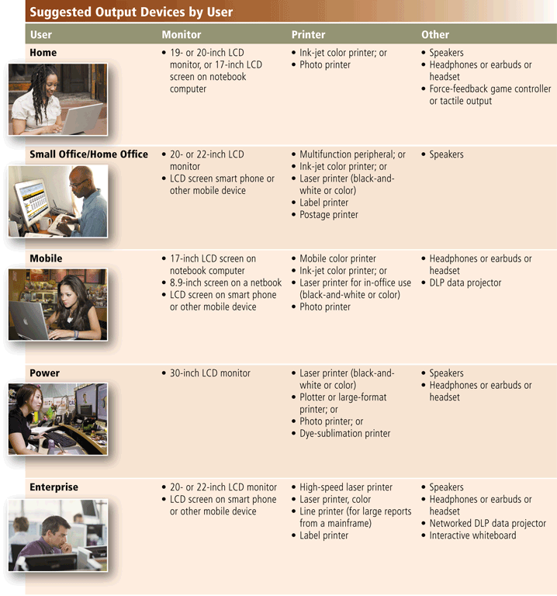
Putting It All Together
Page 327
Figure 6-32

Slide 40
Putting It All Together
Page 327
Figure 6-32

Slide 41
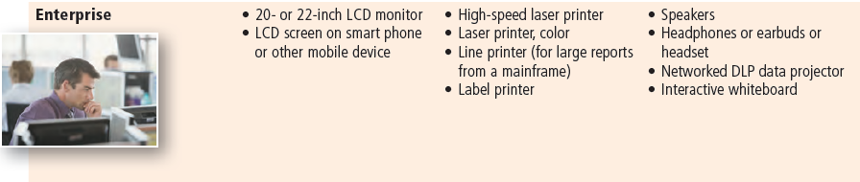
Putting It All Together
Page 327
Figure 6-32

Slide 42
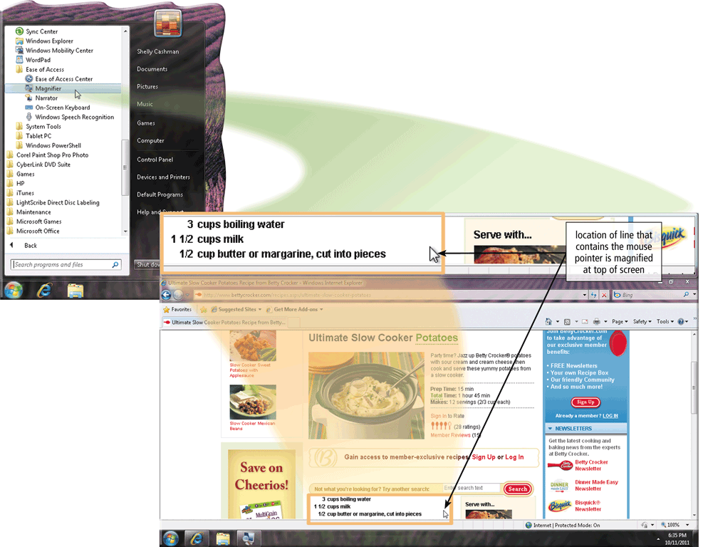
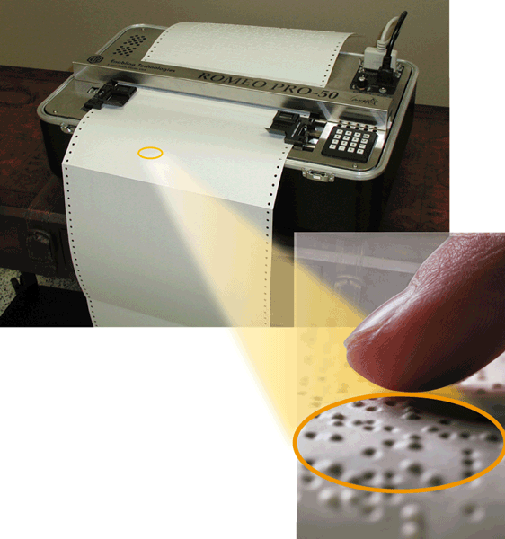
Output Devices for Physically Challenged Users
Many accessibility options exist for users with various disabilities
Pages 328 - 329
Figures 6-33 – 6-34

Slide 43
Summary
Various methods of output
Several commonly used output devices
Display devices, printers, speakers, headphones, earbuds, data projectors, interactive whiteboards, force-feedback game controllers, and tactile output
Page 329

Slide 44
Chapter 6 Complete

